Slide 1
Working with Enterprise JavaBeans (EJB)
New Features of EJB 3.1
LEVEL – PRACTITIONER

Slide 2
Santhanalakshmi Natarajan
SCJP , SCBCD , SCWCD
EJB/PPT/0608/1.0

Slide 3













Icons Used
Questions
Tools
Hands on Exercise
Coding Standards
Test Your Understanding
Case Study
Demonstration
Best Practices & Industry Standards
Icebreaker Activity
Interactive Activity
Additional Learning Sources
Workshop
Session Rules

Slide 4

Session Rules
Please keep your phone on mute during the session.
Please wait for the trainer to pause to take your question.
Please participate in all the quizzes and discussions in the session.

Slide 5
Icebreaker Activity
We have discussed about the new features introduced in EJB 3.1 in day 1 session, Please list out the features in Chat area…
Notes:
Instructions to Trainer:
Singleton Session beans
Asynchronous session bean invocations
EJB Timer Service
Portable JNDI Names
Embeddable EJB container
EJB 3.1 Lite
Instructions to Facilitator:

Slide 6
EJB 3.1 Features :Overview
Introduction:
The following new features are introduced in EJB 3.1 version
Singleton Session beans
No Interface View
Simplified Packaging
Asynchronous session bean invocations
EJB Timer Service (Not covered in the training)
EJB 3.1 Lite

Slide 7
EJB 3.1 Features: Objectives
Objective:
After completing this chapter, you will be able to:
Use Singleton Session beans
Simplify the EJB packaging in war file
Understand No Interface View
Understand the asynchronous session bean invocations
Understand the Usage and limitation of EJB 3.1 Lite
7

Slide 8
Singleton Session Bean
One instance per bean type per JVM
Provides easy sharing of State
Designed for Concurrent access
Similar to other session beans on other functionalities such as
Support to Container Managed Transaction and Bean Managed Transaction
No Interface, Local , Remote views are supported
Container services which are available to session beans
@startup – to specify the singleton be initialized eagerly

Slide 9
Singleton Session Bean
@Singleton
@Startup
public class PropertyRegistry {
private final Properties properties = new Properties();
@PostConstruct
public void applicationStartup() {
properties.putAll(System.getProperties());
}
@PreDestroy
public void applicationShutdown() {
properties.clear();
}
public String getProperty(String key) {
return properties.getProperty(key);
}
public String setProperty(String key, String value) {
return (String) properties.setProperty(key, value);
}
public String removeProperty(String key) {
return (String) properties.remove(key);
}

Slide 10
Singleton Session Bean
Concurrency options
Container Managed Concurrency (CMC) - default
Bean Managed Concurrency (BMC)
Container Managed Concurrency (CMC) - Container takes care of the concurrent access of the bean based on metadata information provided in the XML or annotation.
LockType.WRITE, LockType.READ are the two locking meta data which can be configured at Class and Method level
Methods default to LockType.WRITE

Slide 11
Singleton Session Bean
Bean Managed Concurrency
Bean developer is responsible for integrity of instance state
Allows finer concurrency control of instance state
The implementation can use
Java.util. concurrency.locks.* API
Synchronized keyword
Courtesy :oracle.com

Slide 12
Singleton Session Bean
Bean Managed Concurrency Example
@Singleton
@ConcurrencyManagement(BEAN)
public class CacheBean {
public synchronized in getData(int key){
return cache.getValue();
}
public void update(int key, int value){
synchronized (this){
cache.setValue(key, value);
}
}
}

Slide 13
No Interface View
No interface view is similar to EJB3.0 local view
All public methods of the bean are automatically exposed to local client
Example
@Stateless
Public class TestBean{
public String testData(String data){
….
}
}
Client code
@EJB
Private TestBean testBean;
….
String data=testBean.testData(“input”);

Slide 14
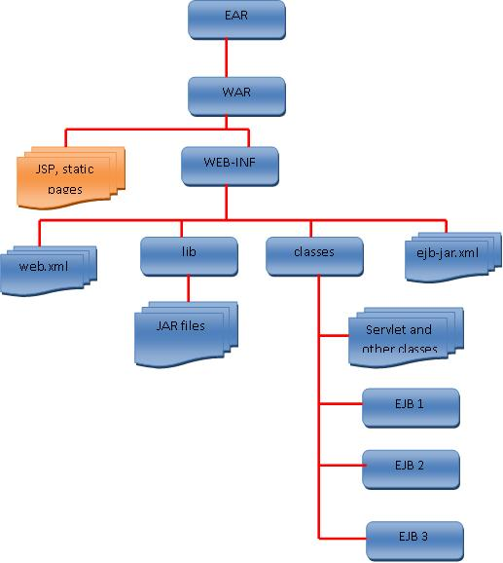
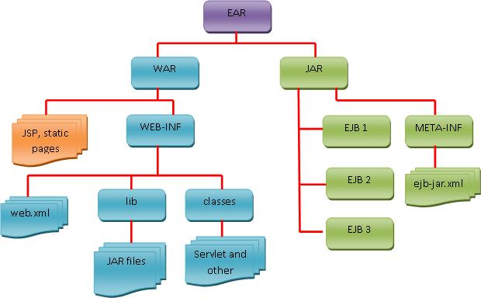
Simplified Packaging
EJB classes can be packaged directly in WARs
EJB 3.1 package Structure
JEE package Structure
Courtesy: developer.com

Slide 15
Interactive Activity
State True of False
The No Interface view applicable for remote client of enterprise beans
Notes:
Instructions to Trainer:
Instructions to Facilitator:

Slide 16
Interactive Activity
Which is the default concurrency option ?
BMC
CMC
Notes:
Instructions to Trainer:
Ans:Container Managed Concurrency
Instructions to Facilitator:

Slide 17
Asynchronous Session Bean Invocation
EJB 3.1, the session bean can support asynchronous method invocations.
@Asynchronous annotation in the session bean method
Control returns to client before actual business method invoked
No persistence guarantee as of MDB
No Transaction propagation from caller to callee (as invocation is asynchronous)
Return Values
Void type (similar to onMessage method)
Java.util.concurrent.Future

Slide 18
Asynchronous Session Bean Invocation
@Stateless
Public class CalculatorBean implements CalculatorService {
...
@Asynchronous
public Future<Integer> performCalculation(...) {
// ... do calculation
Integer result = ...;
return new AsyncResult<Integer>(result);
}
}
18

Slide 19
Portable JNDI Names
No Need to learn vendor specific JNDI Names
java:global/<App-Name>/<Module-Name>/<Bean-Name> /<Fully-Qualified- Interface-Name>
Example
If TestBean is packaged in myModule.jar in test.ear, then JNDI entries
Java:global/test/myModule/TestBean
Java:app/myModule/TestBean
Java:module/TestBean

Slide 20
EJB Lite
The EJB specification has large set of features for developing a wide variety of enterprise applications
EJB 3.1 introduced EJB Lite, a minimal subset of EJB APIs that still includes all the required features for creating an enterprise ap

Slide 21
EJB Lite
EJB Lite has the following subset of EJB APIs:
Session bean components
Stateless
Stateful
Singleton session beans
Supports only synchronous invocation
Transaction
Container-managed transaction and bean-managed transaction
Security
Declarative and programmatic security
Interceptors
Support for deployment descriptor (ejb-jar.xml)

Slide 22
Interactive Activity
Discussion
In Asynchronous session bean method invocation, is it recommended to return void instead of Future object?
Justify your answer
Notes:
Instructions to Trainer:
Instructions to Facilitator:

Slide 23
Learn How – Demonstration

Slide 24
Interactive Activity
Instructions:
Enter details of an interactive exercise that the participants can perform.
Provide an interactive activity for every 10-15 slides of session. The interactive activity can be any of the following:
Quiz
Polls
Role play
Games
Practical exercises
Discussions
Use chat/ annotations/whiteboard/polls/raise hand or change status/application sharing/breakout rooms/audio/icons.
Notes:
Instructions to Trainer:
Instructions to Facilitator:

Slide 25
Questions

Slide 26
Test Your Understanding
26
Notes:
Answer :
Distributed application, transaction management and reusable components
Session bean, entity bean, message driven bean
False
False

Slide 27
EJB 3.1 Features: Summary
The following features are introduced in EJB3.1
Singleton Session beans
EJB packaging in war file
No Interface View for local access
asynchronous session bean invocations
EJB 3.1 Lite
27

Slide 28
Additional Learning Sources
Enterprise JavaBeans 3.1, 6th Edition - O'Reilly Media
http://publib.boulder.ibm.com/infocenter/radhelp/v8/index.jsp?topic=%2Fcom.ibm.rad.samptut.doc%2Ftutorials%2Fejb%2Ftopics%2Findex.html

Slide 29

Introduction to EJB: Source
http://www.oracle.com/technetwork/java/ejb-141389.html
http://www.developer.com/java/ejb/article.php/3881841/EJB-31-The-EJB-Application-Gets-Simpler-More-Flexible.htm
Disclaimer: Parts of the content of this course is based on the materials available from the Web sites and books listed above. The materials that can be accessed from linked sites are not maintained by Cognizant Academy and we are not responsible for the contents thereof. All trademarks, service marks, and trade names in this course are the marks of the respective owner(s).
29

Slide 30
Working with Enterprise JavaBeans (EJB)
You have successfully completed -
New Features of EJB 3.1

